Slide 1

Fog Computing
https://commons.wikimedia.org/wiki/File:Golden_Gate_Bridge_fog_2014.jpg
… Cloud Computing at the Edge of the Network

Slide 2
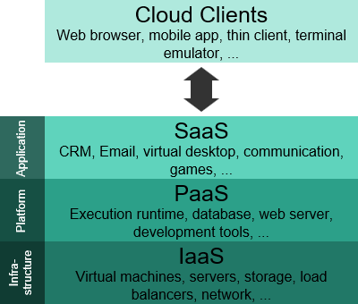
Cloud Computing
AWS definition:
The on-demand delivery of compute power, database storage, applications, and other IT resources through a cloud services platform via the internet with pay-as-you-go pricing.
https://commons.wikimedia.org/wiki/File:Cloud_computing_layers.svg

Slide 3
The Edge of the Cloud
Why isn’t cloud computing sufficient for some applications?
  Latency – Real-time interaction (delay is important)
    Video Streaming – Movies, Video Conferencing
    Gaming – Role playing games
    Augmented Reality – Pokémon Go
    Industrial applications – factory / machine control
  Geographical Distribution – Widely distributed deployments (overload, sync)
    Massively Multiplayer Online Real-time Games
    Route Planning / Traffic
  Mobile Deployment – Nodes will be moving (changing latency & quality)
    Cell phones
    Vehicles
  Large number of Nodes – too much data & traffic for one backend
    Networks of sensor nodes

Slide 4
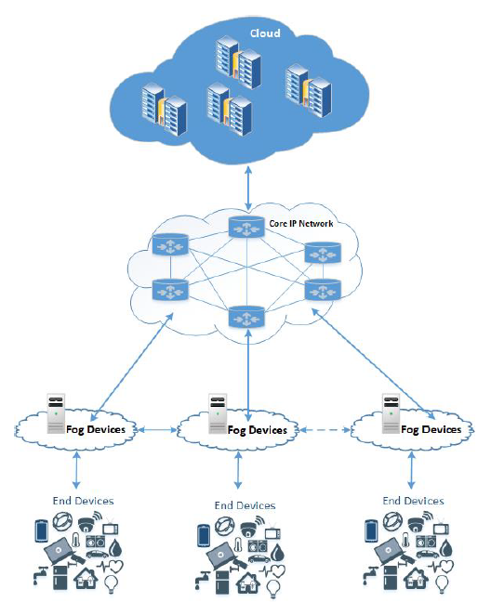
Fog Computing
Fog platform provides low-latency virtualized services and is linked to the Cloud Computing infrastructure.
Edge devices request compute, storage, and communication services from the Fog. The Fog provides local, low-latency response to these requests and forwards relevant data for computationally intensive processing.
Local computation / coordination – e.g. drones
Local storage / caching – e.g. YouTube
Data routing to a cloud – e.g. aggregation
Fog Computing: Survey of Trends, Architectures, Requirements, and Research Directions

Slide 5
Fog Computing Example
Smart security camera
Edge computing (inside of each camera)
  Motion detection
  Object detection
  Dropping irrelevant frames (shadows, cats, etc)
  Local buffering
Fog computing
  Facial recognition
  Alert sending
  Local storage for 72 hours
  Video feed aggregation (from several cameras)
Cloud computing
  Permanent storage
  Heavy algorithms & Analytics
  Push-notifications
  Web interfaces
Fog Computing: Survey of Trends, Architectures, Requirements, and Research Directions

Slide 6
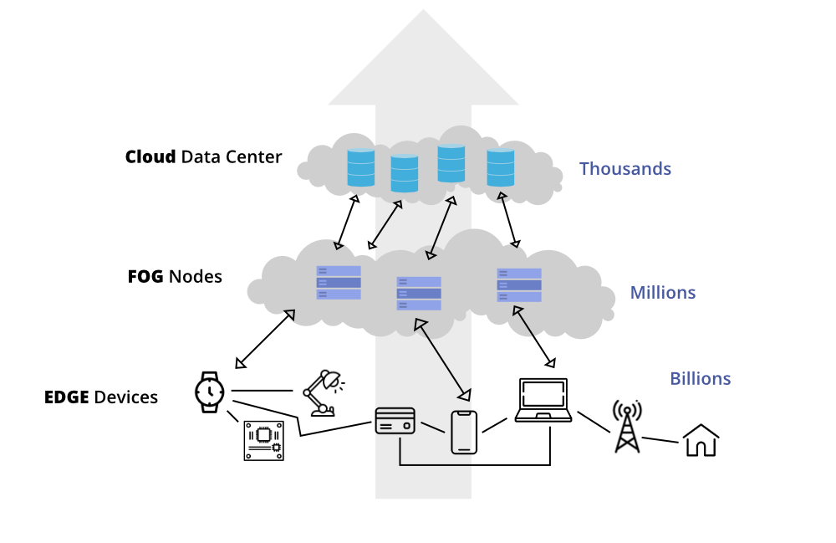
Fog vs Edge
Fog Computing: Survey of Trends, Architectures, Requirements, and Research Directions

Slide 7
Exemplars: Content Delivery
Netflix – evolving business model.
  1998: Initially mail-order DVDs, competing with Blockbuster brick and mortar stores.
    Order on-line
    DVDs delivered by mail
  2007: Started deliver content via internet
  Fine in the cloud
    Billing, subscriptions, accounts, personalization, media catalog, metadata, content transcoding, analytics, monitoring, etc
  Content – how to deliver?
    300+ million subscribers, 190+ countries
    15% of Internet traffic in 2023
  2011: Development of Open Content Delivery – a network set up to move content closer to the consumer
Notes:
Push content closer to consumer – reduce latency and performance
Risks – security, servers residing outside your direct sphere of influence
-- Synchronization problems, not so much a problem for a video, but potential issue for gaming

Slide 8
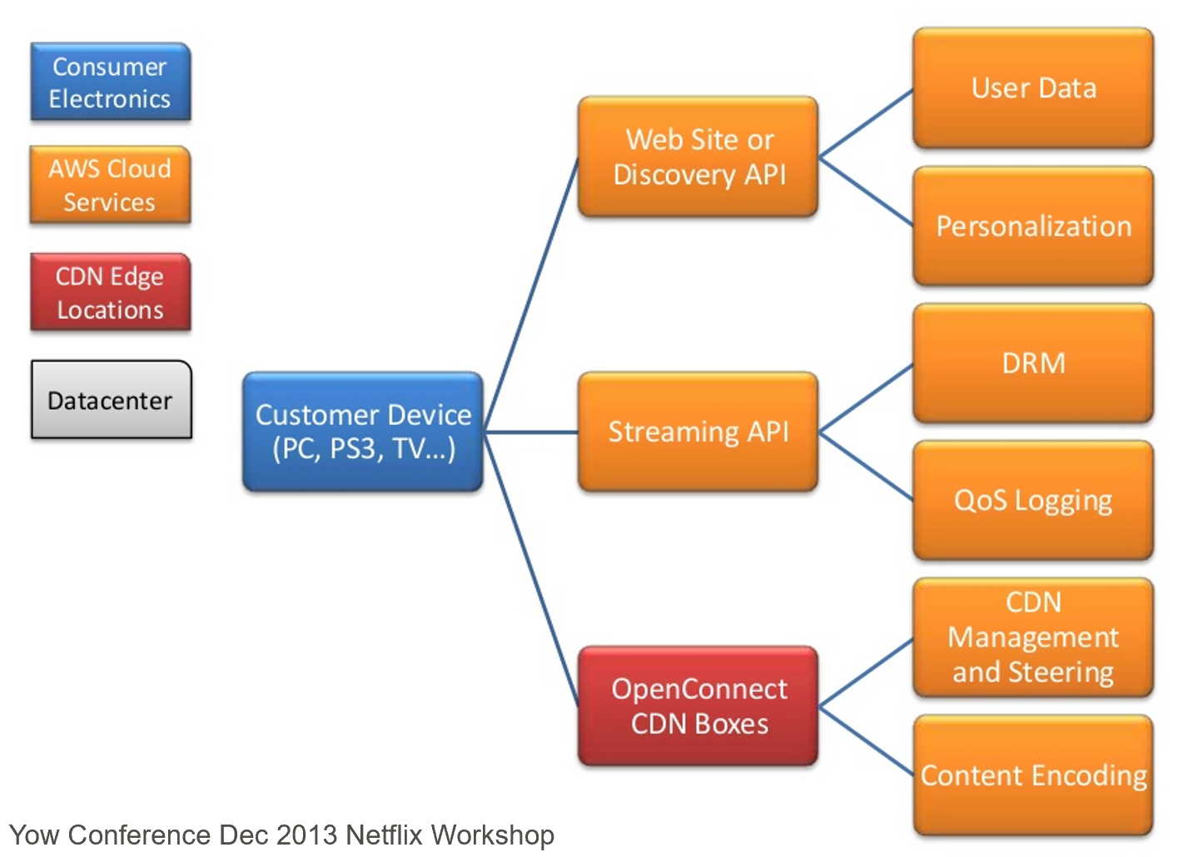
How Netflix Streaming Works

Slide 9
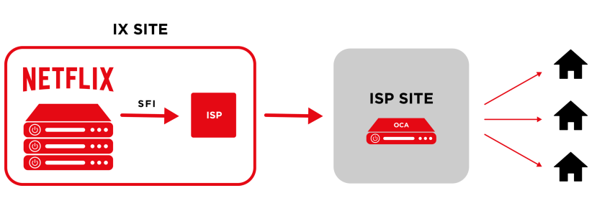
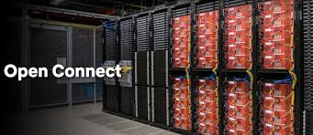
Netflix
IX – Internet Exchange Points
SFI – Settlement Free Peering
OCA – Open Connect Appliance

Slide 10
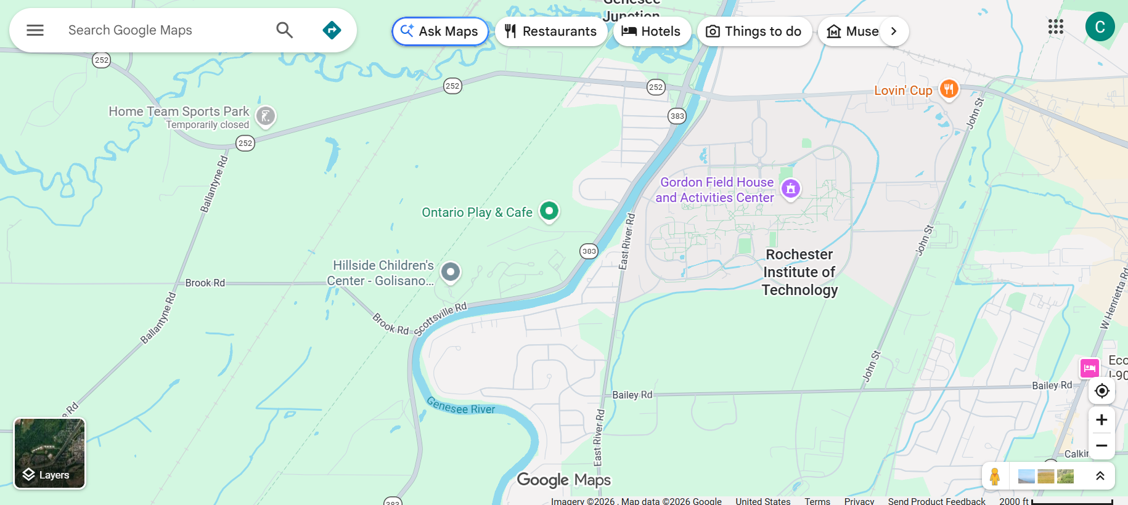
Exemplars: Real-time Mapping
Edge
  Location
  Map tile caching
  Predictive routing micro decisions
  etc
Fog
  Cache (data, frequent search, etc)
  Map tile delivery
  Some local data
  Local routing
  etc
Cloud
  Full map database
  Historical traffic analytics
  etc
Notes:
Luc Vincent – Google, pioneered Street View

Slide 11
Fog Computing Characteristics
  Low Latency – Video Delivery, Navigation Information
  Location Awareness – Traffic Lights, Navigation, Sensor Networks
  Wide-spread Geographical Distribution
  Mobility – Fitness Trackers, Phones and Vehicles

Slide 12
Fog Computing Characteristics
  Very Large Number of Nodes
IoT Device Connections
Source: IoT Analytics, State of IoT 2025 (iot-analytics.com)
Notes:
CAGR = Compound Annual Growth Rate

Slide 13
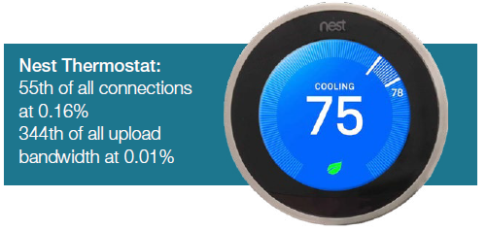
Fog Computing Characteristics
  Predominance of Wireless Access
  Strong presence of Streaming and Real-time Applications
  Heterogeneity
    Abstracts heterogeneity
    Mediates differences
  Offloads workload from weak devices, etc
www.sandvine.com/hubfs/downloads/phenomena/2018-phenomena-report.pdf

Slide 14
Architectural Drivers
Low Latency / Real Time Response – Device will want near real-time response for content delivery and actionable information
Dynamic Number of Nodes – Number of devices within the Fog is dynamic. System must be able to handle large number of devices joining and leaving the Fog
Highly Mobile Nodes – Nodes will be entering and exiting the Fog and the Fog must adapt and continue to perform
Diverse Set of Failure Modes – Wide range of devices with varying levels of sophistication mean there will be many failure modes that need to be seamlessly handled
Security – Access control
Notes:
Issues to think about – Security & data synchronization

Slide 15
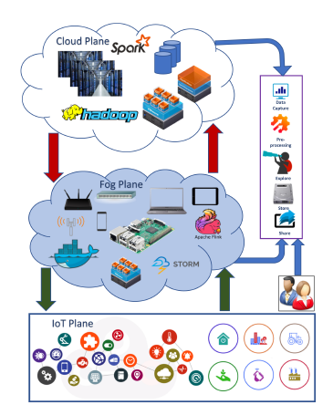
Layered Pattern for Fog Computing
Fog Computing: Survey of Trends, Architectures, Requirements, and Research Directions

Slide 16
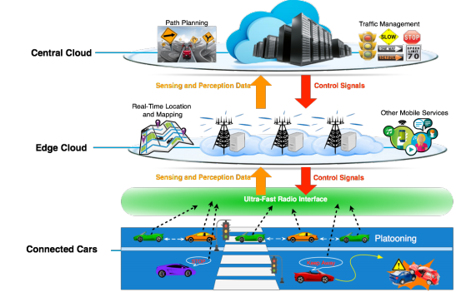
Exemplar: Autonomous Vehicle Platooning
https://arxiv.org/pdf/1701.01090.pdf

Slide 17
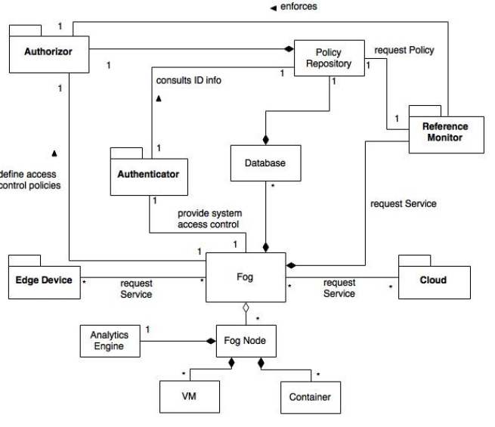
Fog Computing Pattern

Slide 18
Reading Assignment:
A Pattern for Fog Computing: https://www.researchgate.net/publication/314101893_A_Pattern_for_Fog_Computing
Be prepared to address a couple questions about this paper on Friday, November 13.

